Slide 1
Image Processing on the Driver Station using Python
Dustin Spicuzza (Team 2423/1418)
December 7, 2013
Team 1418 Workshops

Slide 2
Agenda
Why Driver Station + OpenCV + Python?
Simple demos
hello_world.py
hello_webcam.py
Practical Example: 2013 FRC Game
Driver Station software demo
pynetworktables

Slide 3
Why the Driver Station
You can use any laptop for the driver station
As much power as your team can afford
Even really cheap laptops are more powerful than the cRio
Easier to develop/debug code on the driver station
You can run the code on your development computer, no robot required

Slide 4
Why OpenCV?
Originally developed by Intel
It has thousands of image processing related algorithms and functions available
Highly optimized and reliable
Has building blocks that fit together
Lets you do complex image processing without needing to understand the math
If you understand the math, it helps!

Slide 5
Why OpenCV?
Bindings for multiple languages
C/C++
Java
Python
Multiple platforms supported
Windows
Linux
OSX
Android
Oh, and it’s FREE!

Slide 6
What OpenCV provides
Image I/O:
Read/Write images from disk
Use native OS functionality to interface with cameras
Image Segmentation
Edge finding
Contour detection
Thresholding

Slide 7
What OpenCV provides
Face detection
Motion tracking
Stereo vision support
Support for GPU acceleration
Machine learning operations
Classifiers
Neural networks

Slide 8
What OpenCV provides
Distributed with lots of useful samples that you can use to figure out how OpenCV works
Face detection
Edge finding
Histograms
Square finder
Lots and lots and lots of stuff…

Slide 9
Why Python+OpenCV?
Python is really easy to learn and use
Simple syntax
Rapid prototyping
Most of the compute intensive work is implemented in C/C++
Python is just glue, realtime operation is possible
NumPy is awesome
Manipulating image data is trivial compared to other OpenCV bindings (Java, C++)

Slide 10
Hello World!
Create an image, show it using the GUI
import cv2
import numpy as np
# create a numpy array to hold the data
# -> w=200, h=100, channels=3
img = np.zeros(shape=(100,200,3), dtype=np.uint8)
# write red text to image (note BGR, not RGB!)
cv2.putText(img, "Hello World!", (50,50),
cv2.FONT_HERSHEY_PLAIN, 1, (0,0,255))
cv2.imshow('Image', img)
cv2.waitKey(0)

Slide 11
Hello Webcam!
Capture from a webcam, show it
import cv2
vc = cv2.VideoCapture()
if not vc.open(0):
print "Could not connect to webcam"
exit(1)
while cv2.waitKey(30) <= 0:
success, img = vc.read()
if not success:
break
cv2.imshow("Webcam", img)

Slide 12
OpenCV Image Basics
Images are stored as multidimensional arrays
Color images have 3 dimensions: height, width, channel
Each pixel is a number stored in the array
Numpy array notation allows you to do operations on individual pixels or ranges of pixels
img[24, 42, 0] # access a single pixel
img[24:42, 42:100, :] # access a range of pixels

Slide 13
OpenCV Image Basics
Color is represented by storing combinations of Red, Blue, and Green pixels in separate channels
OpenCV uses BGR representation, not RGB
The amount of each individual color is represented in the individual channel
‘dark’ is zero, ‘bright’ is 255
Combine the channels to represent a color
Green = RGB( 0, 255, 0 )
Deep Pink = RGB( 255, 20, 147 )

Slide 14
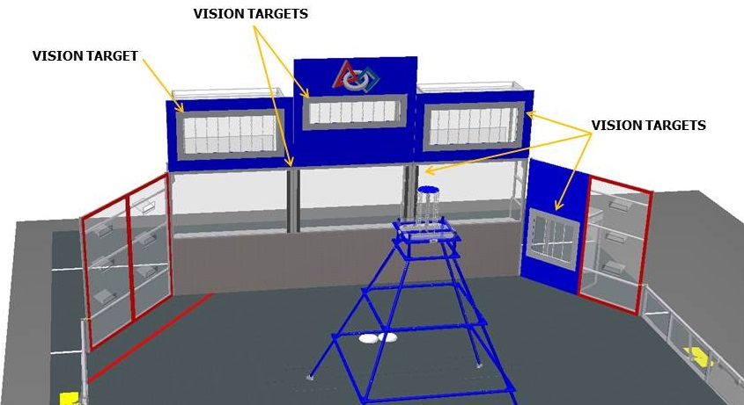
Practical Example
2013 challenge: find targets that are surrounded by retroreflective tape, and shoot frisbees into them
The tape reflects light directly back at source
Src: http://frc-manual.usfirst.org

Slide 15
Practical Example
Finding gray tape at a distance isn’t particularly easy
Key part of image processing is removing as much non-essential information from image
We can do better!
Shine bright LEDs at the target and the tape reflects that color back to the camera
Many teams have found that green light works best
Reduce exposure of camera so only bright light sources are seen

Slide 16
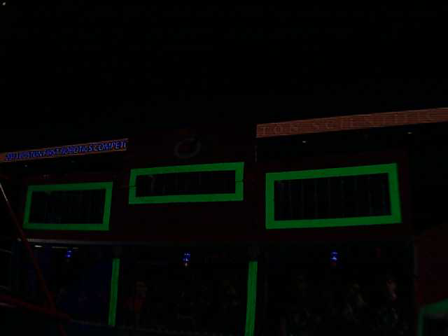
Practical Example
Result:

Slide 17
Practical Example
Processing steps to find targets
Isolate the green portions of the image
Analyze the green portions to determine targets

Slide 18
Identify the green
What is “green” anyways?
This is green. This is also green.
To a computer, green is really a range of colors
An object’s color changes depending on lighting conditions
We can transform the image to identify colors independent of lighting conditions

Slide 19
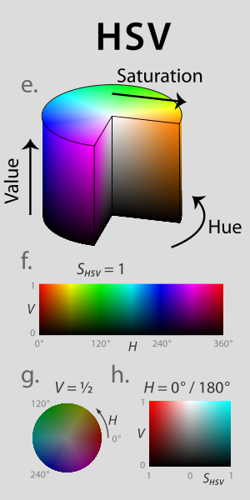
Identify the green
Convert the image from RGB to HSV
Hue: the color
Saturation: Colorfulness
Value: Brightness
hsv = cv2.cvtColor(img,cv2.cv.CV_BGR2HSV)
http://en.wikipedia.org/wiki/File:Hsl-hsv_models.svg

Slide 20
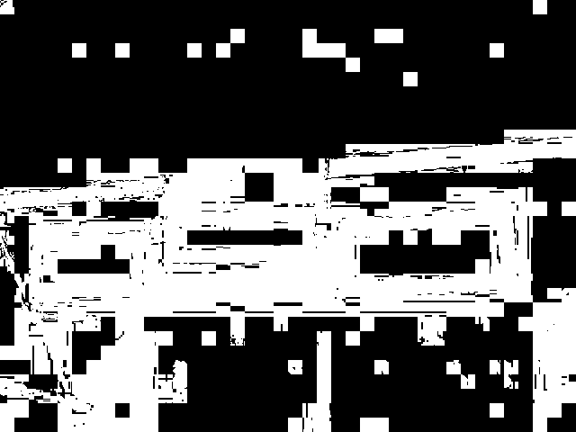
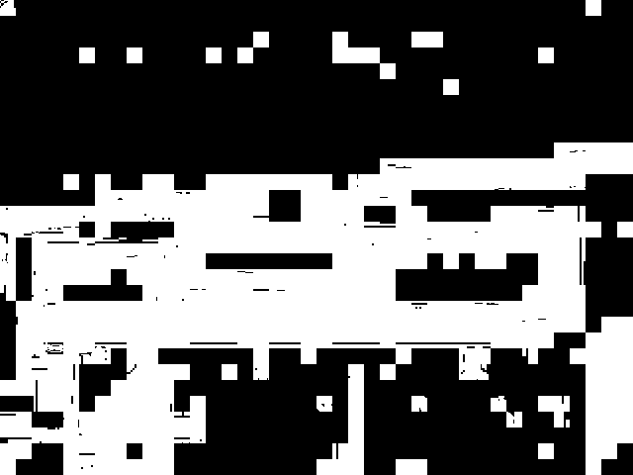
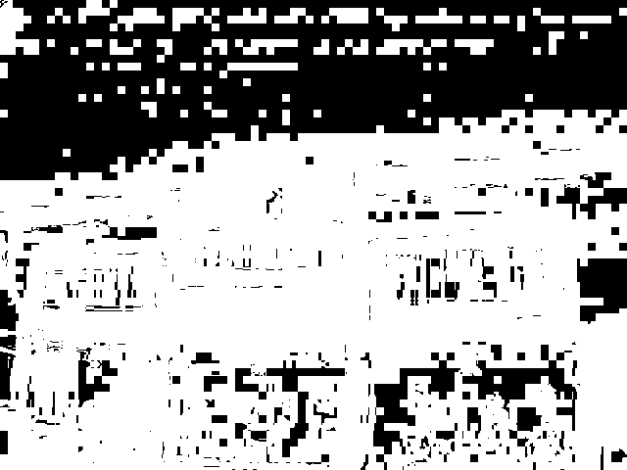
Identify the green
H
Split view of converted image (H, S, V)
Compression artifacts are clearly present
S
V

Slide 21
Identify the green
Green is a range of values present in the image
‘Threshold’ the image to get rid of the colors that we don’t care about
Lots of ways to do this
Manually specify values
Automated methods

Slide 22
Identify the green
We can use the ‘Threshold’ function to find values between a low and high value
Wanted values are converted to 255
Unwanted values are now 0
def threshold_range(im, lo, hi):
unused, t1 = cv2.threshold(im, lo, 255, type=cv2.THRESH_BINARY)
unused, t2 = cv2.threshold(im, hi, 255, type=cv2.THRESH_BINARY_INV)
return cv2.bitwise_and(t1, t2)

Slide 23

Identify the green
Threshold each channel, combine the results
Note there are little holes in the image where the color doesn’t quite line up…

Slide 24
Identify the green
We can use a morphological operation to fill in the holes
Various types of morphology operations available
They modify a pixel based on the values of its neighboring pixels
The one we use to fill in holes is a “closing” operation
kernel = cv2.getStructuringElement(cv2.MORPH_RECT, (2,2), anchor=(1,1))
output = cv2.morphologyEx(img, cv2.MORPH_CLOSE, kernel,
iterations=9)

Slide 25
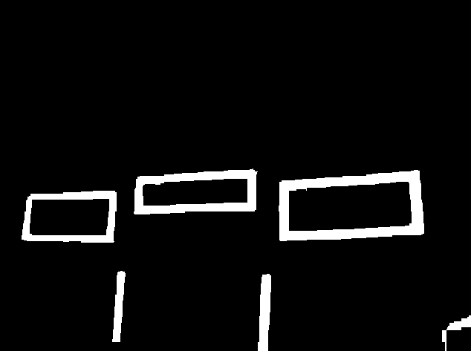
Identify the green
The output looks a lot better now!

Slide 26
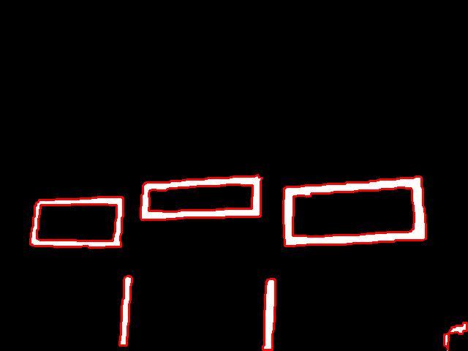
Identifying Targets
Use findContours() to find regions of interest
Returns a list of points bounding each separate blob in the image (called a contour)
There’s a drawContours function
Also returns a hierarchy so you can determine whether a contour is entirely inside another contour

Slide 27
Identifying Targets
Contour analysis
Discard non-convex contours
Convert to polygon approximation (approxPolyDP)
Discard polygons that aren’t rectangles
Find a minimal rotated bounding rectangle to perform analysis on (minAreaRect)

Slide 28
Identifying Targets
Target analysis
Determine ratio of rectangle sides to see if they match target sizes
Ensure rectangles have at least one horizontal line and two nearly vertical lines
Remove duplicates (inner part of rectangle)

Slide 29
Identifying Targets
Target analysis
Determine from ratio (w/h) whether it’s a top/middle/low target
Targets at each level are different sizes
Determine from relative position whether it’s the left or right target we’re looking at
The left middle target will always be the target left of a top target, etc..

Slide 30
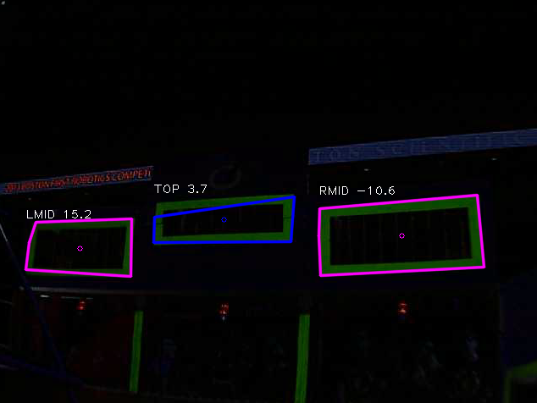
Identifying Targets
Draw pretty pictures and labels, and we’re done!

Slide 31
Getting the data to the robot
We identified the targets… now what?
You can use NetworkTables to get the data there
On the robot, it’s in WPILib (C++, Java, LabVIEW)
Off the robot, SmartDashboard talks to the robot via NetworkTables
In python, we use pynetworktables to communicate via NetworkTables

Slide 32
Getting the data to the robot
Sample code to transmit a number via NetworkTables in python:
from pynetworktables import NetworkTable
# Set the robot’s IP address here
NetworkTable.SetIPAddress(‘10.24.23.2’)
NetworkTable.SetClientMode()
NetworkTable.Initialize()
table = NetworkTable.GetTable('SmartDashboard')
table.PutNumber(‘name’, 1)

Slide 33
Want fully-functioning code for this?
Team 2423 implemented all of this in their driver station in 2013
We even won an award!
You can download the code at http://www.virtualroadside.com/FRC/

Slide 34
Resources
Python 2.7.x
http://www.python.org/download/releases/2.7.6/
Learn python
http://www.codecademy.com/tracks/python
OpenCV 2.4.x
http://opencv.org/
Numpy 1.7.x
Official site: http://www.numpy.org/
Optimized builds: http://www.lfd.uci.edu/~gohlke/pythonlibs/#numpy

Slide 35
Resources
pynetworktables
source code + examples https://github.com/robotpy/pynetworktables
windows downloads http://firstforge.wpi.edu/sf/projects/robotpy
Edit & debug python code using Eclipse
Pydev: http://pydev.org/

Slide 36
Questions?

Slide 37
Thanks to
FRC Team 341, whose image processing code was the base for our code in 2013
Sam Rosenblum and Stephen Rawls

